Slide 1

DATASET OF NETFLEX SHOWS
9.24.XX

Slide 2

QUESTIONS
1.How many Shows release per year ?
2.How many Shows have which type of rating ?
3.Find the number of shows released by type in which year ?
4.How many Comedies shows were released in which year ?
5.Find the IMDB rating which movies and tv shows by year ?
6.Which Country Released Movies and TV shows in which year ?
7.Distribution of netflex shows by year by rating ?
8. Find the number of Shows release which Country by year ?
9. Find the number of Shows by IMDB Rating Group ?
10.Find the sum of the IMDB Rating by Country ?
11. In which year, Which type of Shows has been released ?
12. Specify the number of Shows by rating ?

Slide 3
How many Shows release per year ?

Slide 4
How many Shows have which type of rating ?

Slide 5
Find the number of shows released by type in which year ?

Slide 6
How many Comedies shows were released in which year ?

Slide 7

A SATISFIED CUTOMER
Find the IMDB rating which movies and tv shows by year ?.

Slide 8
Which Country Released Movies and TV shows in which year ?

Slide 9
Distribution of Netflex shows by year by rating ?

Slide 10
Find the number of Shows release which Country by year ?

Slide 11
Find the number of Shows by IMDB Rating Group ?

Slide 12
Find the sum of the IMDB Rating by Country ?

Slide 13
In which year, Which type of Shows has been released ?

Slide 14

Specify the number of Shows by rating ?
+1 (589) 555-0199

Slide 15
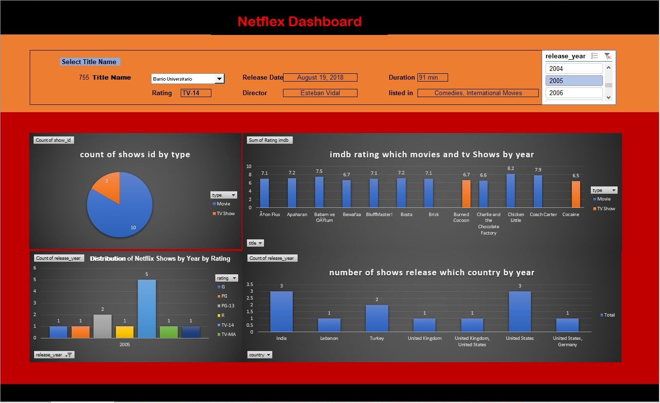

Slide 16
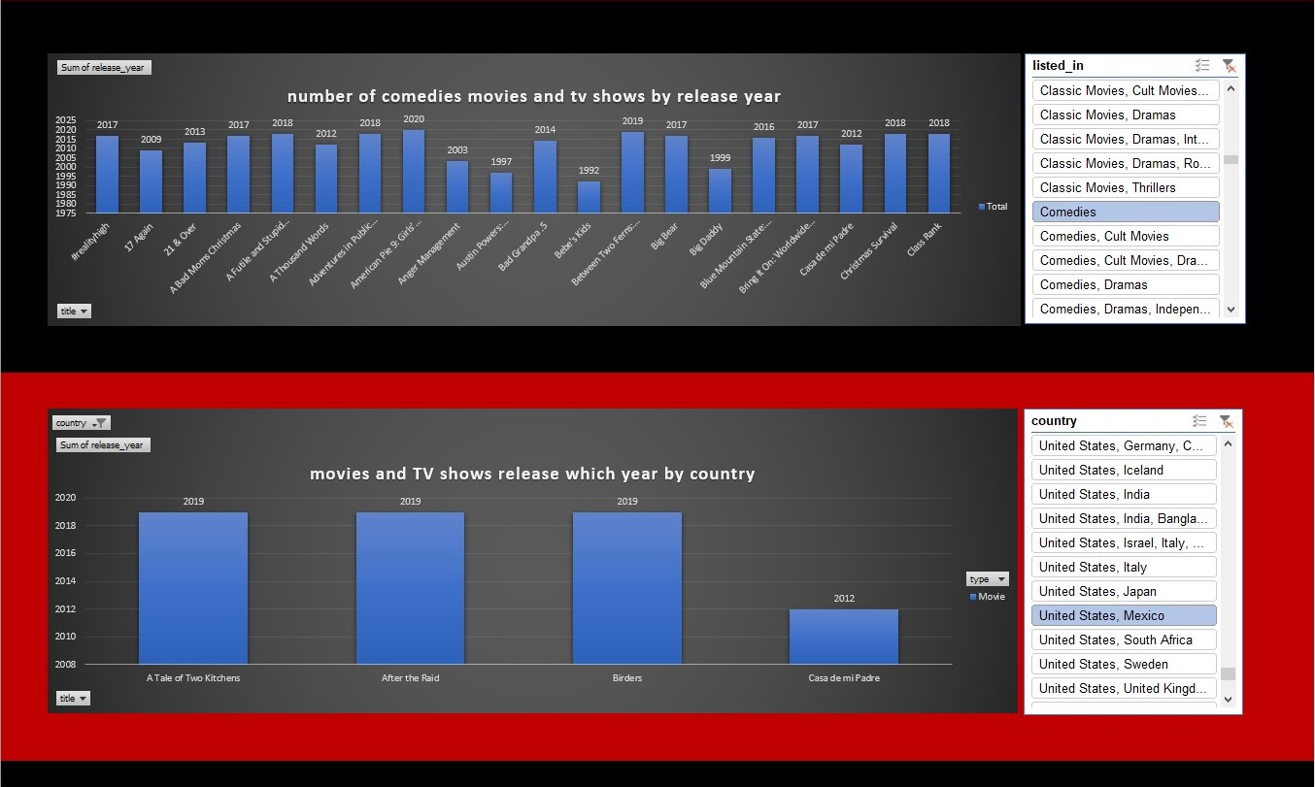

Slide 17
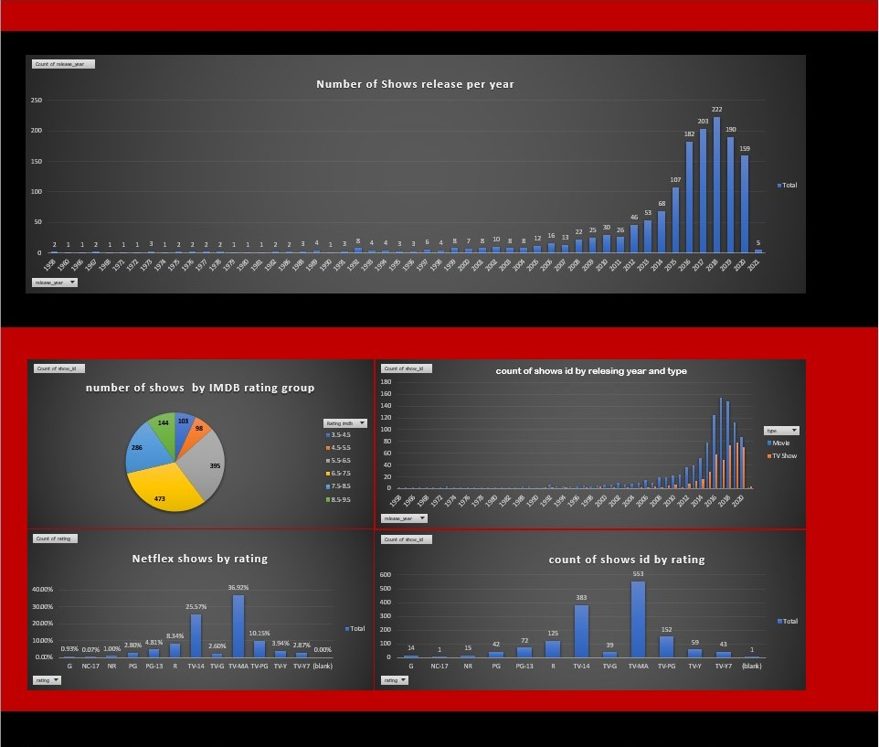

Slide 18
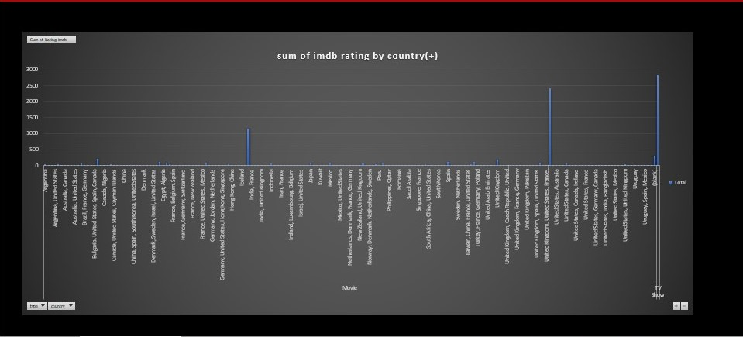

Slide 19
THANK YOU
Created by : Kamal Pratap Singh

